Slide 1
Reinforcement Learning: Flappy Bird
Jin Hui Xu

Slide 2
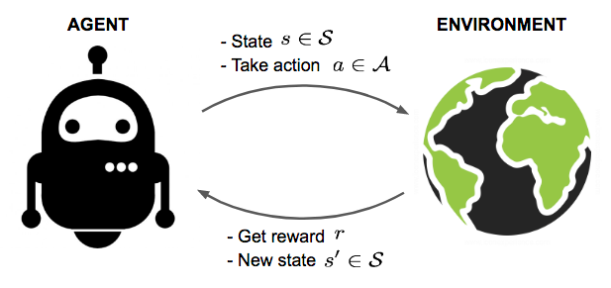
Reinforcement Learning
An agent can obtain some rewards by interacting with the given environment.
RL is the process to train our agent to take smart actions to maximize cumulative rewards.

Slide 3
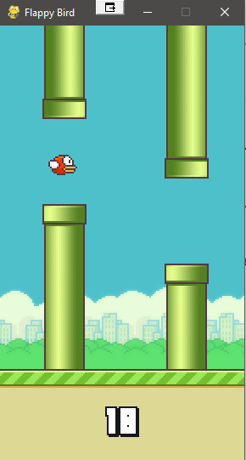
Environment: Flappy Bird
A popular mobile game in early 2014 (web version: https://flappybird.io/)
Environment:
Two actions: Fly up or take no action (drop)
Rewards: +0.1 when the agent stays alive
+1 when the agent passes a pair of pipes
-2 when the agent hits the ground or pipes and game over
Maximum cumulative rewards: keep the agent alive as long as possible
Python version is developed by using pygame library

Slide 4
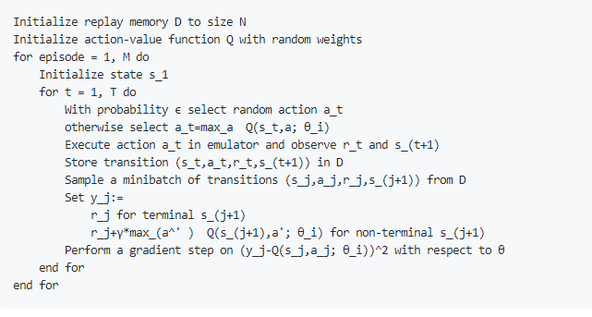
Model: Deep Q-Network
DQN combines neural networks with Q learning algorithm

Slide 5
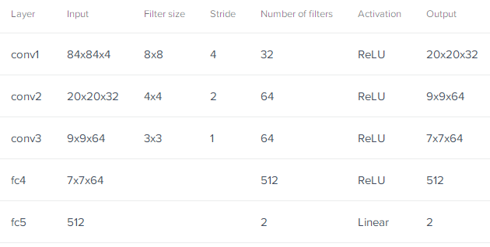
DQN Implementation: CNN + Q-Learning
CNN architecture

Slide 6
DQN Implementation (Cont.)
The FPS for the environment is 30 which means we have 30 state images and are able to perform 30 actions per second.
In order to predict an action per state, we fit 4 consecutive images to the CNN. The CNN will output two Q values reflecting the two action options.
Fly up
CNN
Collect rewards and update Q values by Q algorithm
Drop
The procedure of learning for one state

Slide 7
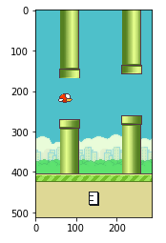
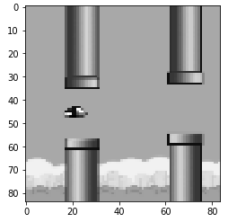
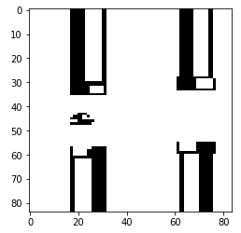
Model Training
Image preprocessing by OpenCV
Scale image to a smaller size and convert it to grayscale improve the speed of model convergence

Slide 8
Demo
Training, Pretrained models and training summary

Slide 9
Conclusion
This is a simple game for applying reinforcement learning. The well trained agent can outperform human in this given environment.
Reinforcement learning doesn't rely on labeled datasets
The same approach can be applied to more complex applications in real world in many fields, such as healthcare, finance, advertisement, robotics, video game, and etc.

Slide 10
References
https://github.com/dusty-nv/jetson-reinforcement
https://github.com/yenchenlin/DeepLearningFlappyBird
https://www.toptal.com/deep-learning/pytorch-reinforcement-learning-tutorial
https://opencv24-python-tutorials.readthedocs.io/en/latest/index.html

